Slide 1

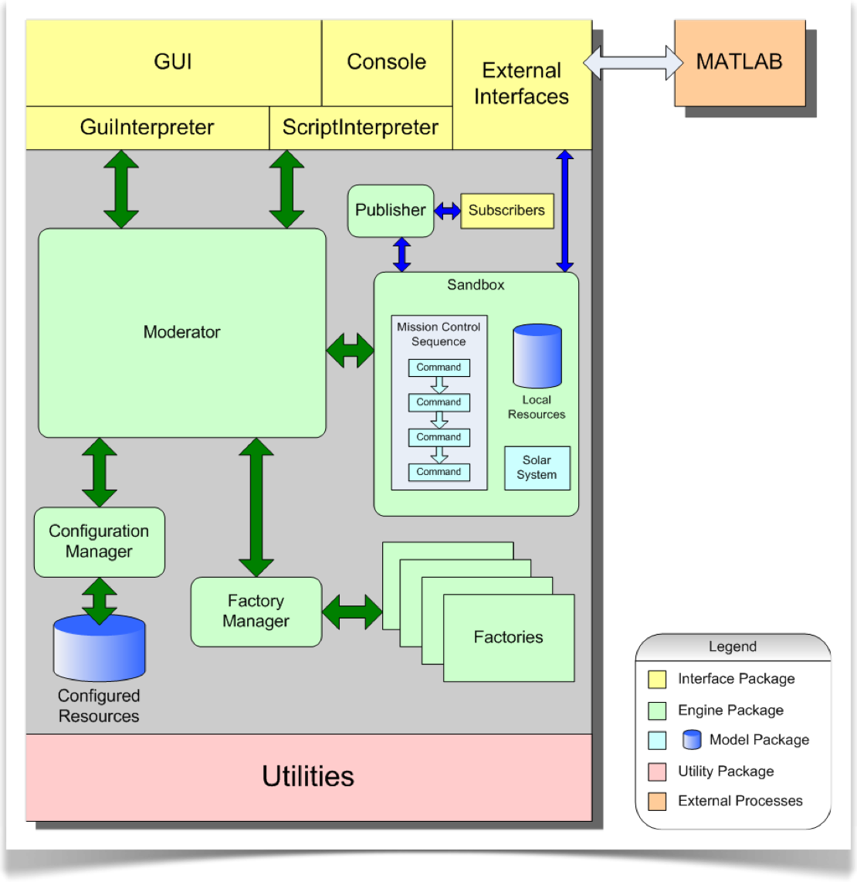
GMAT Architecture

Slide 2
Agenda
Architectural Overview
How GMAT’s Engine Works
GMAT Model Classes

Slide 3
Agenda
Architectural Overview
How GMAT’s Engine Works
GMAT Model Classes

Slide 4
Architectural Overview
GMAT Code falls into 4 Categories:
  The Engine
  User Elements
  User Interfaces
  Utilities

Slide 5
GMAT Components

Slide 6
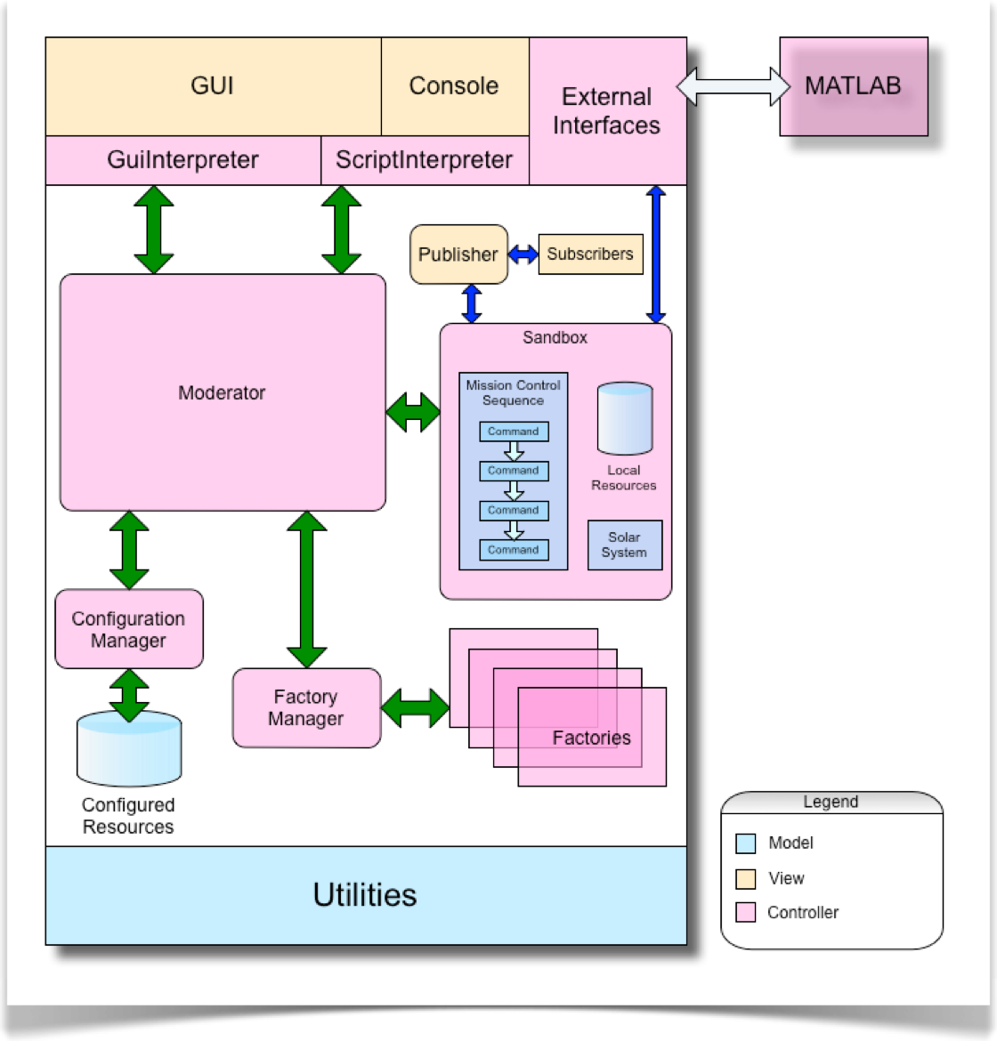

GMAT as a Model-View-Controller System

Slide 7
GMAT Model Elements
Model ELements are in the Base Code
All Derived from GmatBase Classes
Resources
  SpacePoints
  Hardware
  Solvers
  Variables
Commands

Slide 8
GMAT Views
Input Views:
  Scripts
  The GUI
  The Console Application
Output Views
  Reports
  OrbitView and GroundTrack
  Plots

Slide 9
GMAT Controller: The “Engine”
The Moderator
  GMAT’s Master Controller
  Acts as Communications Switchboard
The Configuration
  Manager for All Model Elements
Factories
  Create User Objects
  Provide Key Interfaces for Plug-In Libraries
Sandboxes
  The GMAT Workspace when a Mission is Running
  Design Allows Multiple Sandboxes
Interpreters
  The Interface between GMAT Model and User Input Views

Slide 10
Agenda
Architectural Overview
How GMAT’s Engine Works
GMAT Model Classes

Slide 11
How GMAT Works
On Launch:
  Moderator Created
  Moderator Creates Other Engine Objects
  Plugins Loaded
On Script Load:
  Objects Created and Stored In Configuration
  Timeline Created

Slide 12
How GMAT Works (cont’d)
On Run:
  Moderator Clones Configuration into Sandbox
  Sandbox Initializes Objects
  Mission Timeline Is Run
  Output Views Generated
On Save:
  Objects Serialized to File

Slide 13
Agenda
Architectural Overview
How GMAT’s Engine Works
GMAT Model Classes

Slide 14
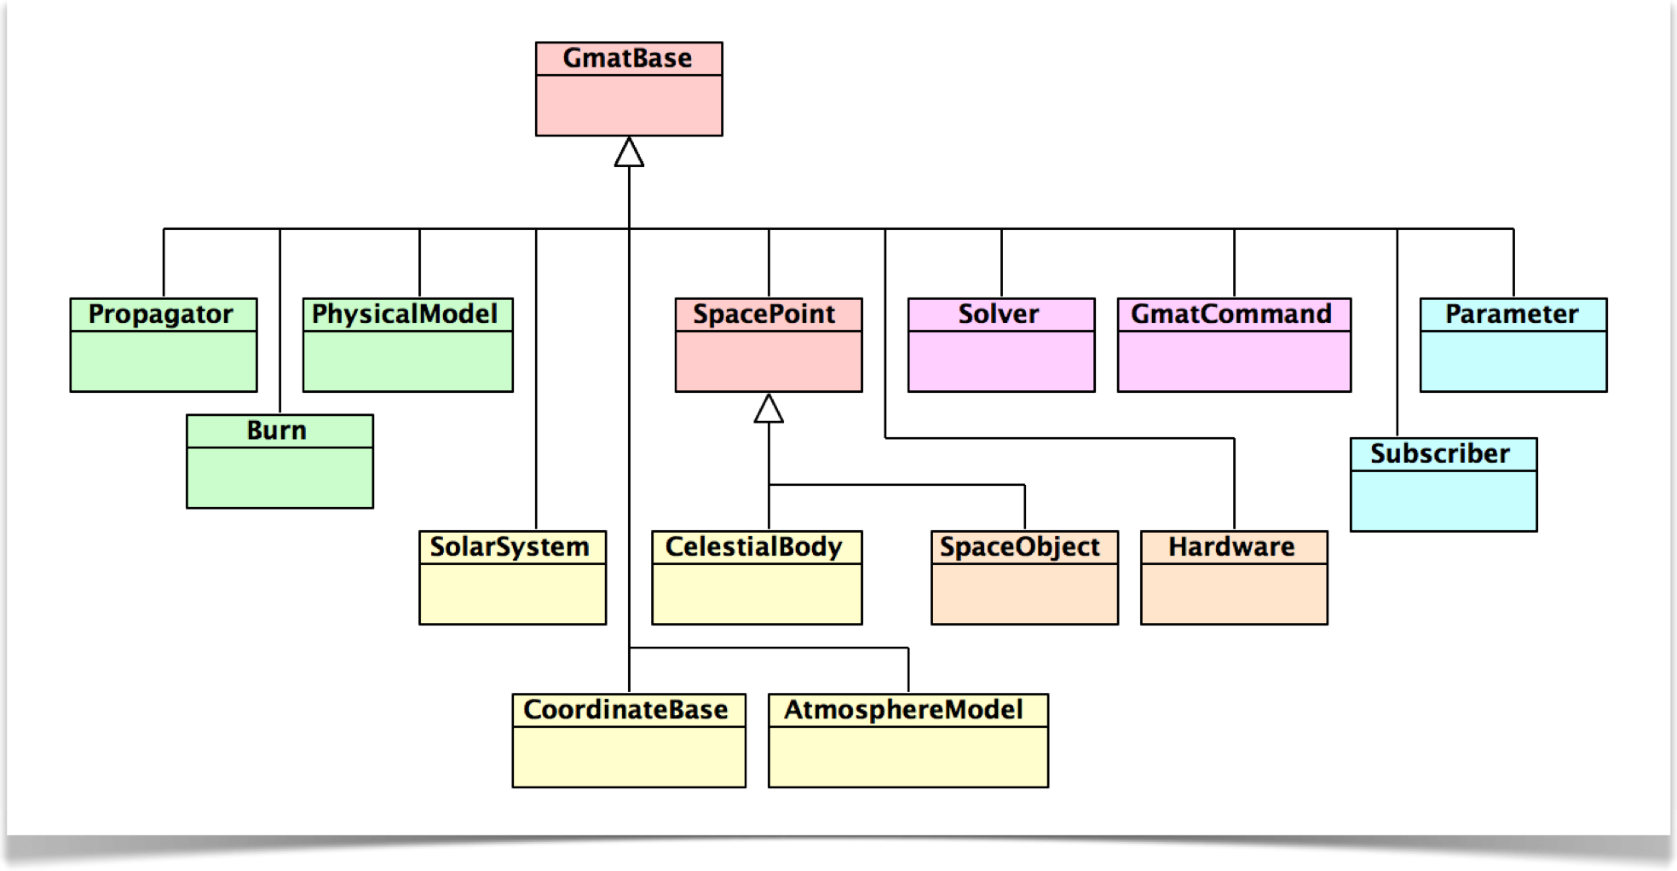
Top Level Class Hierarchy

Slide 15
GmatBase
Model Elements All Derive From GmatBase
Configured Objects have Names
Model Objects have Types
Defines Scripted Parameter Fields
  ParameterCount
  Parameter Types
Provides Accessors to Parameters
  Real GetRealParameter(id),
  Real SetRealParameter(id, value),
  ...
  Similarly for other data types
Provides Script Interfaces
  std::string GetGeneratingString(...)
Provides Object Interconnection Methods
  GetRefObjectNameArray(type), SetRefObject(type, name)
Provides Object Renaming Interface
  RenameRefObject(type, oldName, newName)

Slide 16
Example: Burn
class GMAT_API Burn : public GmatBase{public: Burn(Gmat::ObjectType type, const std::string &typeStr, const std::string &nomme); virtual ~Burn(); Burn(const Burn &b); Burn& operator=(const Burn &b); // Inherited (GmatBase) methods for parameters virtual std::string GetParameterText(const Integer id) const; virtual Integer GetParameterID(const std::string &str) const; virtual Gmat::ParameterType GetParameterType(const Integer id) const; virtual std::string GetParameterTypeString(const Integer id) const; virtual bool IsParameterReadOnly(const Integer id) const; virtual Real GetRealParameter(const Integer id) const; virtual Real SetRealParameter(const Integer id, const Real value); virtual std::string GetStringParameter(const Integer id) const; virtual bool SetStringParameter(const Integer id, const std::string &value); virtual bool SetStringParameter(const Integer id, const std::string &value, const Integer index);... // for Ref. objects virtual const ObjectTypeArray& GetRefObjectTypeArray(); virtual const StringArray& GetRefObjectNameArray(const Gmat::ObjectType type); virtual bool SetRefObject(GmatBase *obj, const Gmat::ObjectType type, const std::string &name = ""); virtual bool RenameRefObject(const Gmat::ObjectType type, const std::string &oldName, const std::string &newName);... virtual bool Initialize(); virtual bool Fire(Real *burnData = NULL, Real epoch = GmatTimeConstants::MJD_OF_J2000) = 0; DEFAULT_TO_NO_CLONES...
};

Slide 17
Classes for the Projects
Space Weather / Flux File Readers
Attitude Models
Spacecraft Shape Models
Orbit State Representations
Propagators

Slide 18
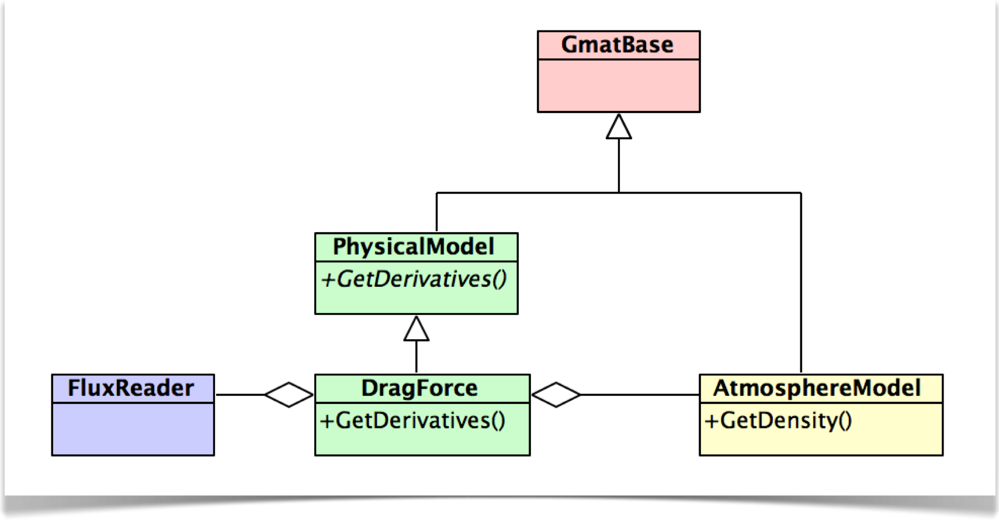
Flux Reader

Slide 19
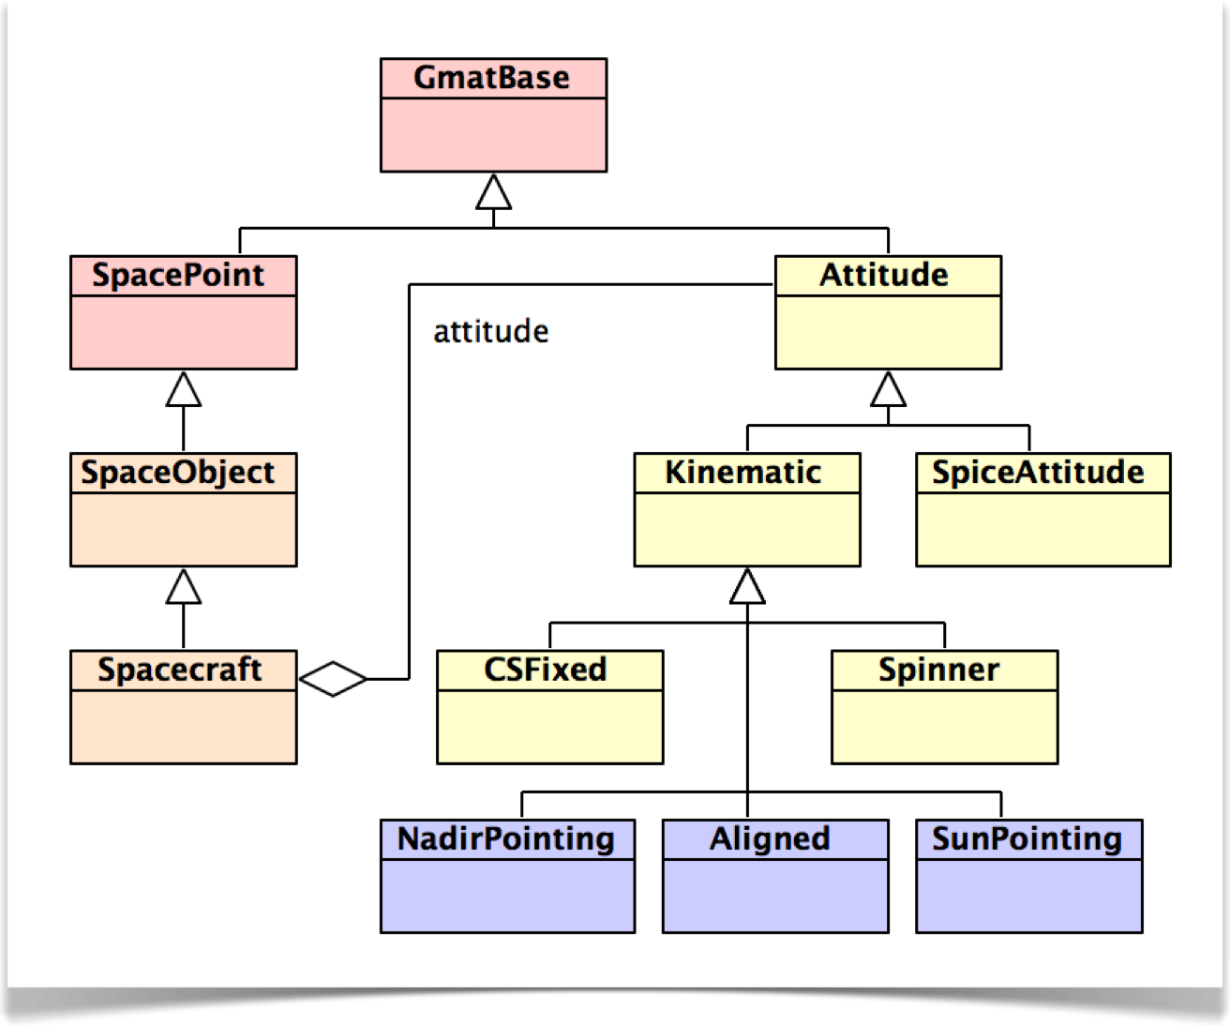
Attitude Classes

Slide 20
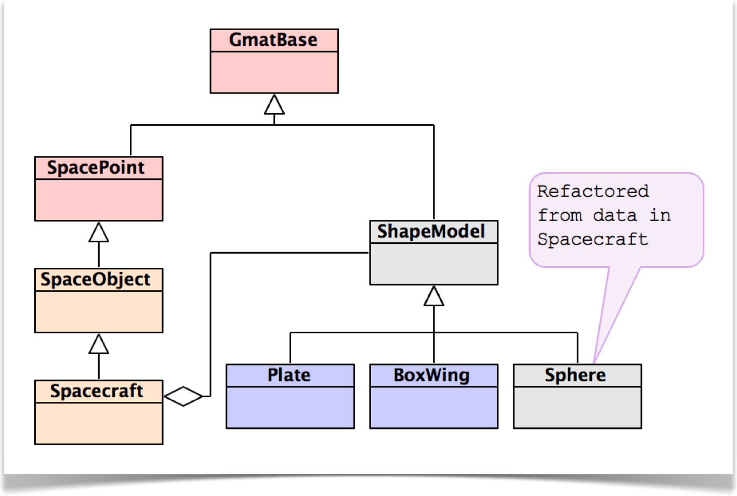
Spacecraft Shape Models

Slide 21
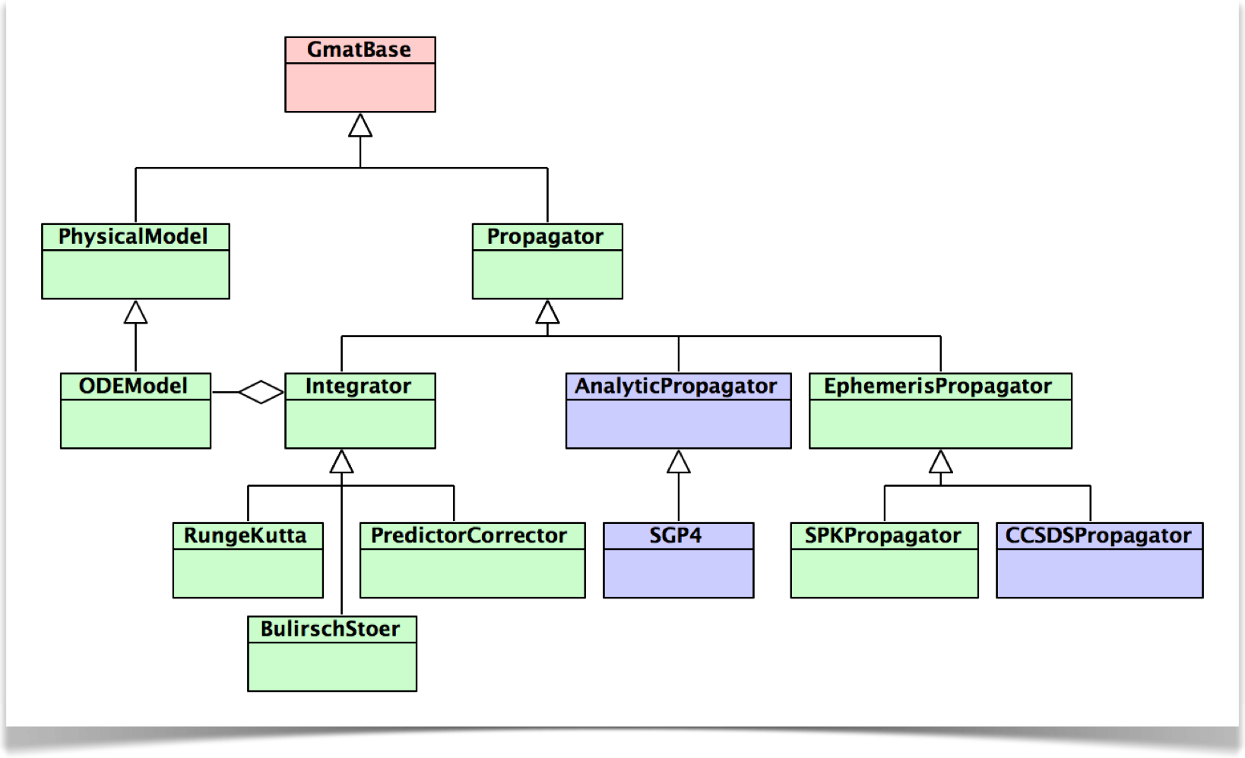
Propagators

Slide 22
Orbit State Representations
Design TBD

Slide 23
Wrap Up
Ways to proceed:
  Look at Code Structure using Doxygen
  Read Some of the Implementation Files
  Ask Lots of Questions!
Questions
Up Next: We’ll Build a Plug-in

